Slide 1
F. Y. BCA
Web Development Using PHP
Chapter I- Introduction to PHP

Slide 2
Looping
for − loops through a block of code a specified number of times.
while − loops through a block of code if and as long as a specified condition is true.
do...while − loops through a block of code once, and then repeats the loop as long as a special condition is true.
foreach − loops through a block of code for each element in an array.
Note : continue and break keywords used to control the loops execution.

Slide 3
Continue & break
Both the statements are of a similar type, and they allow a user to alter/ make changes to the flow of a program.
The primary difference between break and continue statement in C is that the break statement leads to an immediate exit of the innermost switch or enclosing loop.
On the other hand, the continue statement begins the next iteration of the while, enclosing for, or do loop.
In the cases of while and do loops, the continue statement immediately takes control of their test condition. Similarly, it takes control of the loop’s increment step in the case of a for a loop.

Slide 4
break
<?php for ($x = 0; $x < 10; $x++)
{ if ($x == 4)
{ break; } echo "The number is: $x <br>"; } ?>
The break statement can also be used to jump out of a loop.
This example jumps out of the loop when x is equal to 4

Slide 5
Output of break
The number is: 0 The number is: 1 The number is: 2 The number is: 3

Slide 6
Continue
<?php for ($x = 0; $x < 10; $x++)
{ if ($x == 4)
{ continue; } echo "The number is: $x <br>"; } ?>
The continue statement breaks one iteration (in the loop), if a specified condition occurs, and continues with the next iteration in the loop.
The example skips the value of 4

Slide 7
Output of continue
The number is: 0 The number is: 1 The number is: 2 The number is: 3 The number is: 5 The number is: 6 The number is: 7 The number is: 8 The number is: 9

Slide 8
For loop
Syntax:
for (initialization; condition; increment)
{ code to be executed; }
Example:
<html>
<body>
<?php
$a = 0;
$b = 0;
for( $i = 0; $i<5; $i++ )
{
$a += 10;
$b += 5;
}
echo ("At the end of the loop a = $a and b = $b" );
?>
</body>
</html>

Slide 9
While loop
Example:
<html>
<body>
<?php
$i = 0;
$num = 50;
while( $i < 10)
{
$num--;
$i++;
}
echo ("Loop stopped at i = $i and num = $num" );
?>
</body>
</html>
Syntax:
while (condition)
{ code to be executed; }
Output: Loop stopped at i = 10 and num = 40

Slide 10
The do...while loop statement
Example:
<html>
<body>
<?php
$i = 0;
$num = 0;
do
{
$i++;
} while( $i < 10 );
echo ("Loop stopped at i = $i" );
?>
</body>
</html>
Syntax:
do
{ code to be executed; }
while (condition);

Slide 11
The foreach loop statement
Syntax:
foreach (array as value)
{ code to be executed; }
Example:
<html>
<body>
<?php
$array = array( 1, 2, 3, 4, 5);
foreach( $array as $value )
{
echo "Value is $value <br />";
}
?>
</body>
</html>

Slide 12
EXERCISE
Write PHP script to find factorial of a number.
Write PHP script to find fibonacci series.

Slide 13
HTTP GET and POST Methods in PHP
The Hypertext Transfer Protocol (HTTP) is designed to enable communications between clients and servers.
HTTP works as a request-response protocol between a client and server.
A web browser may be the client, and an application on a computer that hosts a web site may be the server.
A client (browser) submits an HTTP request to the server; then the server returns a response to the client. The response contains status information about the request and may also contain the requested content.

Slide 14
Get & post method
There are two HTTP request methods: GET and POST
GET – Requests data from a specified resource.
POST – Submits data to be processed to a specified resource.
In GET method the data is sent as URL parameters that are usually strings of name and value pairs separated by ampersands (&).
In POST method the data is sent to the server as a package in a separate communication with the processing script. Data sent through POST method will not be visible in the URL.

Slide 15
Get method
getdemo.html
<html>
<body>
<form action="getdemo.php" method="GET"/>
Enter name:
<input type="text" name="t1"/><br><br>
Enter age:
<input type="text" name="t2"/><br>
<input type="submit" value="OK"/>
</body>
</html>
getdemo.php
<?php
$name=$_GET['t1'];
$age=$_GET['t2'];
echo "<br> Name : ".$name;
echo "<br> Age : ".$age;
?>

Slide 16
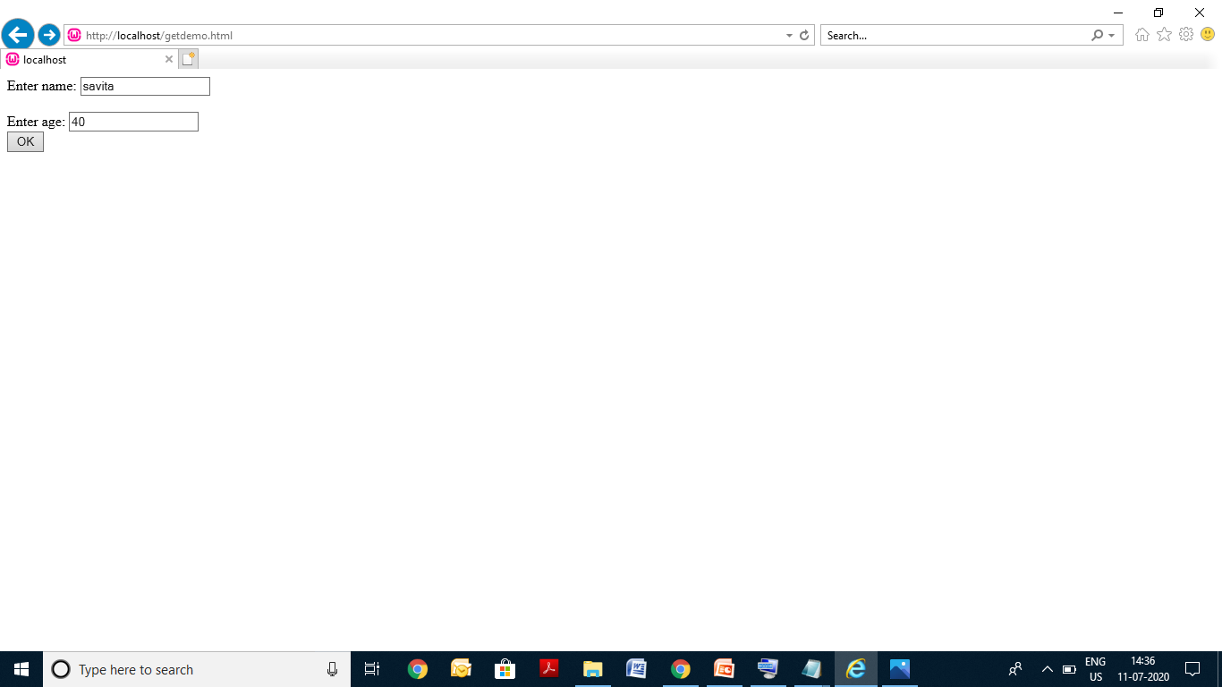

HTML code output using GET method

Slide 17
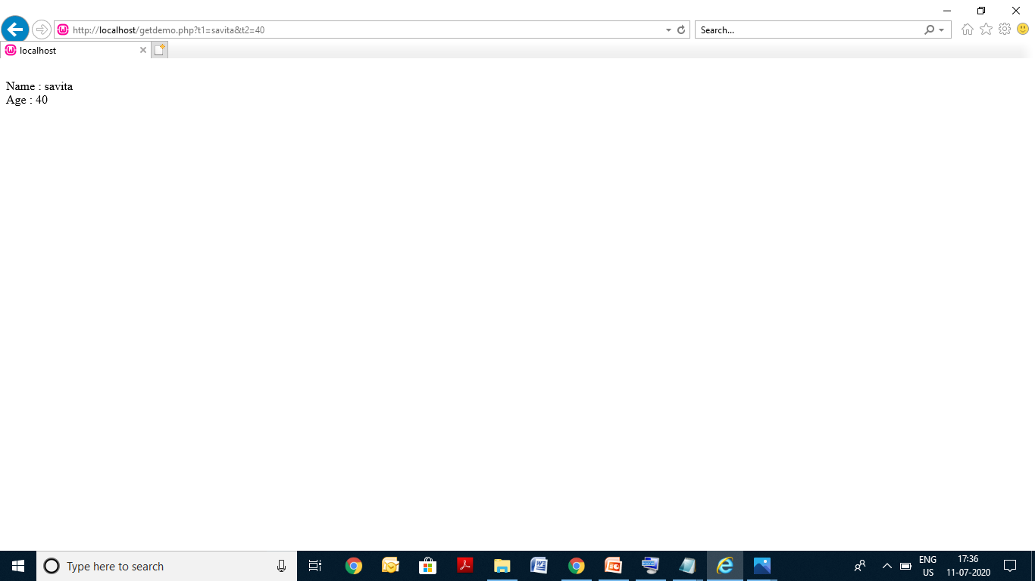
AFTER CLICK ON OK BUTTON using get method

Slide 18
GET Output
On screen
Enter Name :
Enter Age :
OK
On browser
http://localhost/getdemo.php?t1=savita&t2=40
On screen again
Name : savita Age : 40
Note : In GET method the data is sent as URL parameters that are usually strings of name and value pairs separated by ampersands (&).

Slide 19
Get method
The bold parts in the URL are the GET parameters and
the italic parts are the value of those parameters.
More than one parameter=value can be embedded in the URL by concatenating with ampersands (&).
One can only send simple text data via GET method.

Slide 20
Advantages of Using the GET Method
Since the data sent by the GET method are displayed in the URL, it is possible to bookmark the page with specific query string values.
GET requests can be cached and GET requests remain in the browser history.
GET requests can be bookmarked.
disadvantages of Using the GET Method
The GET method is not suitable for passing sensitive
information such as the username and password, because
these are fully visible in the URL query string as well as
potentially stored in the client browser’s memory as a visited
page.
Because the GET method assigns data to a server
environment variable, the length of the URL is limited. So,
there is a limitation for the total data to be sent.

Slide 21
post method
getdemo.html
<html>
<body>
<form action="getdemo.php" method=“POST"/>
Enter name:
<input type="text" name="t1"/><br><br>
Enter age:
<input type="text" name="t2"/><br>
<input type="submit" value="OK"/>
</body>
</html>
getdemo.php
<?php
$name=$_POST['t1'];
$age=$_POST['t2'];
echo "<br> Name : ".$name;
echo "<br> Age : ".$age;
?>

Slide 22

HTML code output using POST method

Slide 23

AFTER CLICK ON OK BUTTON using post method

Slide 24
POST Output
On screen
Enter Name :
Enter Age :
OK
On browser
http://localhost/getdemo.php
On screen again
Name : Saksham Age : 7
Note : In POST method the data is sent to the server as a package in a separate communication with the processing script. Data sent through POST method will not be visible in the URL.

Slide 25
Advantages of php
It is more secure than GET because user-entered information is never visible in the URL query string or in the server logs.
There is a much larger limit on the amount of data that can be passed and one can send text data as well as binary data (uploading a file) using POST.
disadvantages of php
Since the data sent by the POST method is not visible
in the URL, so it is not possible to bookmark the page
with specific query.
POST requests are never cached
POST requests do not remain in the browser history.

Slide 26
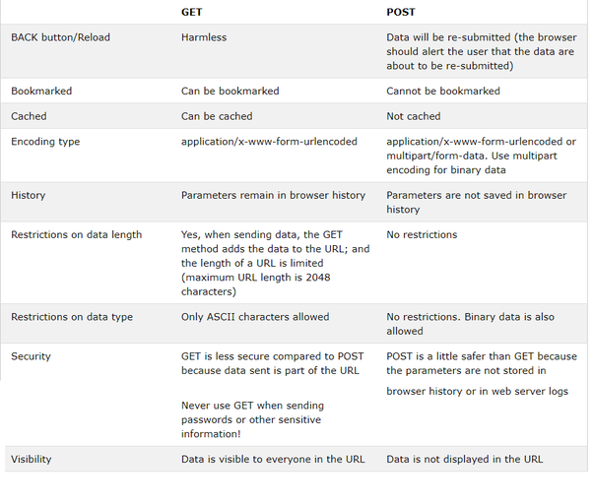

Slide 27
THANK YOU

